Slide 1
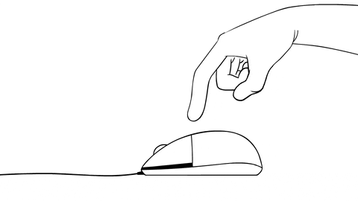
Prediction Of Customer Clicked Ads
Classification by using machine learning

Slide 2
Objective
The primary objective of this project is to showcase the development and implementation of a machine learning model for ad click prediction in digital advertising of an Indonesian Company in their website.
To demonstrate how predictive analytics can be leveraged to enhance ad targeting strategies and optimize campaign performance by delving into the process of data preprocessing, model selection, training, and evaluation.
To highlight the significance of ad click prediction in improving user engagement, maximizing return on investment (ROI), and driving overall business success in the digital advertising landscape.

Slide 3

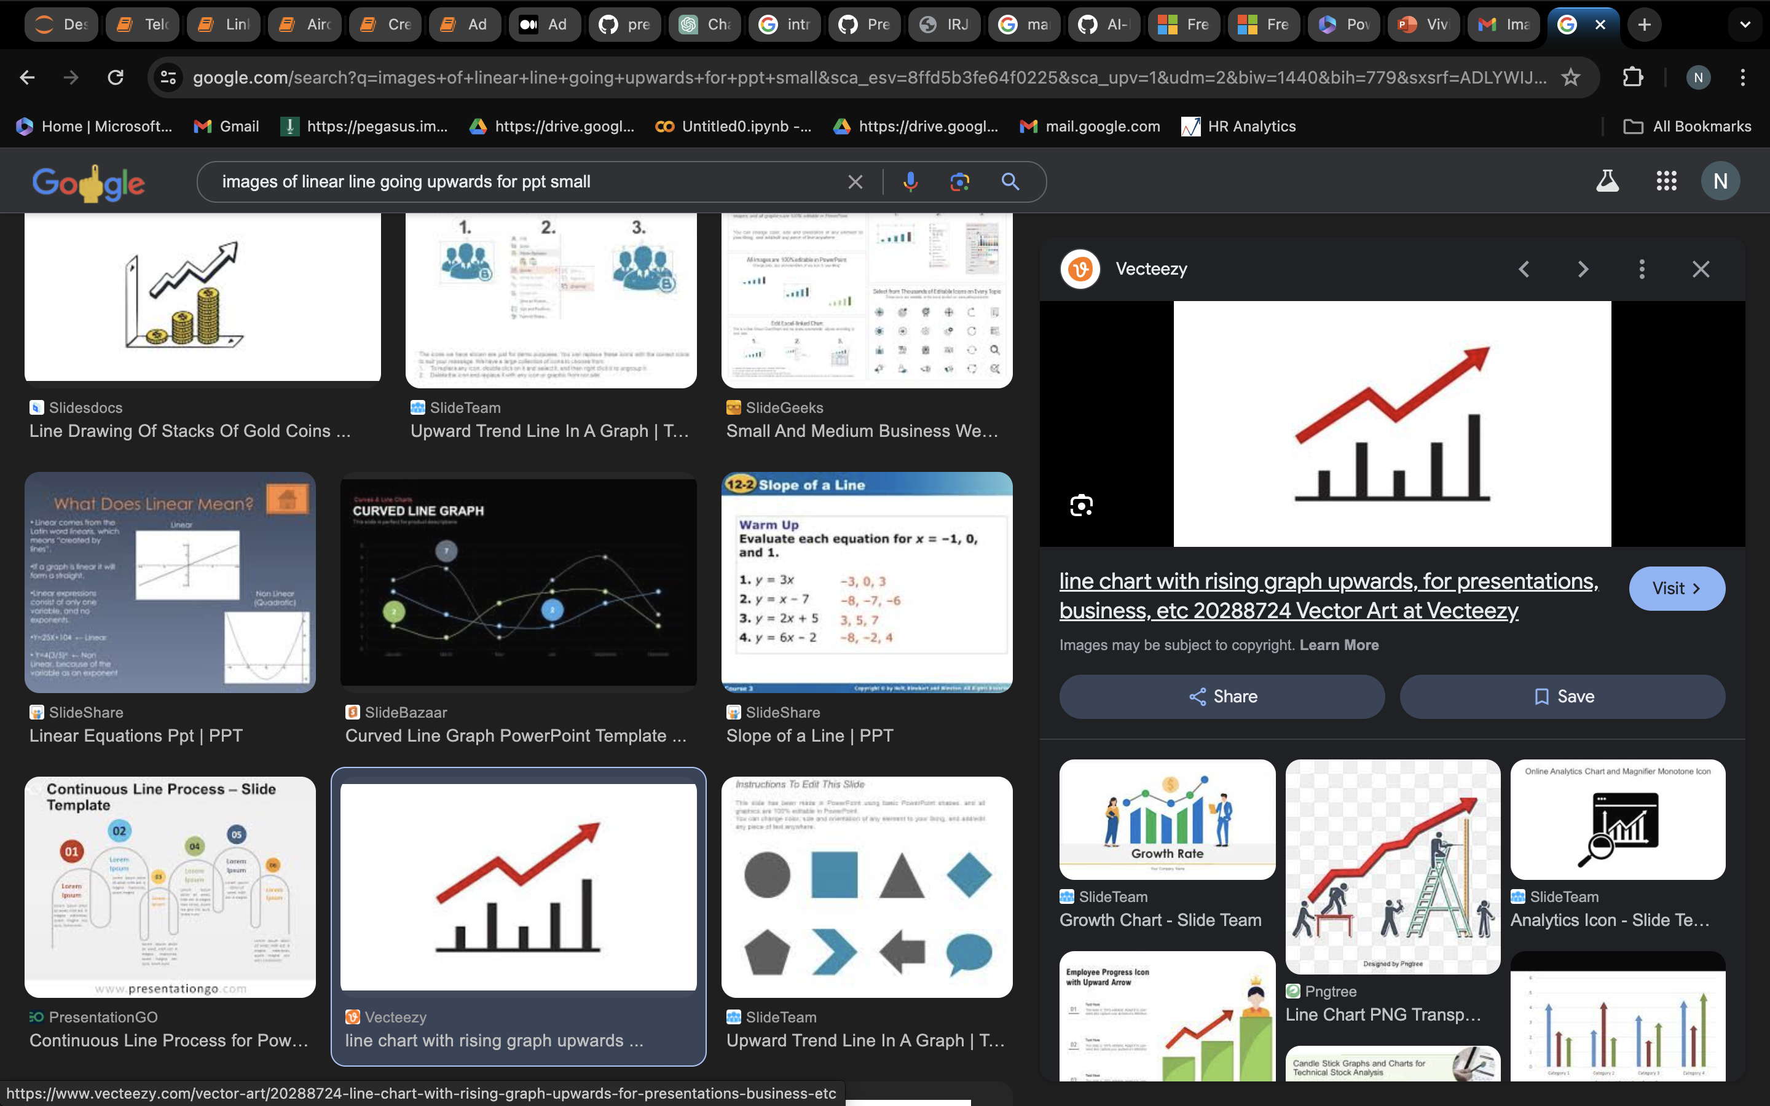
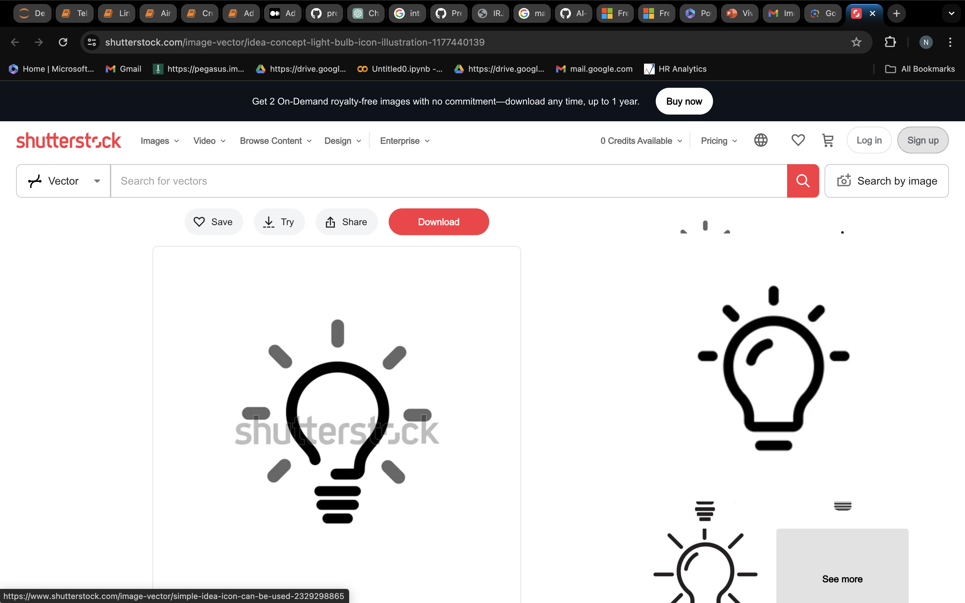
Advantages:
Predicting ad click - through rates is central to the multi-billion dollar online advertising industry.
Different types of ads heavily rely on learned models to predict ad click-through rates accurately, quickly, reliably.
Search engines get paid if users click ads. Thus, it is essential to show the most relevant ads.

Slide 4
Overview
For this project, a dataset sourced from GitHub of an Indonesian Company is utilized, comprising information on 900 ads and whether customers clicked on them. The dataset includes various features that provide insights into user behavior and ad attributes. These features encompass:
Source: https://github.com/mpythree/Predict_Customer_Clicked_Ads_Classification
Daily_Time_Spent_on_Site: The amount of time (in minutes) users spend on the website daily.
Age: The age of the user interacting with the ad.
Area_Income: The average income of the area where the user resides.
Daily_Internet_Usage: The amount of time (in minutes) users spend on the internet daily.
Ad_Topic_Line: The headline or topic of the advertisement.
City: The city where the user is located.
Gender: The gender of the user (e.g., male=1 or female=0).
Country: The country where the user is located.
Timestamp: The timestamp indicating when the ad interaction occurred.
Clicked_on_Ad: A binary variable indicating whether the user clicked on the ad (1) or not (0).

Slide 5
Dataset Summary
Dataset:
Rows: 900
Columns: 10
Daily_Time_Spent_on_Site:
Min: $32.60 USD
Max: $91.43 USD
Age:
Minimum age: 18
Area_Income:
Min: $13996.50 USD
Max: $79484.80 USD
Daily_Internet_Usage:
Min: 104.78 MB
Max: 269.96 MB
Ad_Topic_Line:
Number of topic lines: 900
City:
Number of cities: 894
Gender:
Male: 435
Female: 465
Country:
Number of cities: 234
Timestamp:
Range of time ads clicked:
Start time: 31/05/16 9:06
End time: 01/01/16 15:14
Age:
Minimum age:18
Target Variable:
Clicked on Ad
(Clicked_on_Ad=1)=439
Not clicked
(Clicked_on_Ad=0)=461

Slide 6
Exploratory Data Analysis (EDA)
Data Preprocessing and Cleaning:
Investigate missing values, outliers, inconsistencies and duplicates in the ad click dataset. Explore data distribution and correlations to identify patterns and potential biases.
Feature Engineering and Selection:
Extract relevant features such as time-related variables
Exploratory Data Visualization:
Use interactive visualizations to explore relationships between features and target variables, aiding in model interpretation and validation.

Slide 7
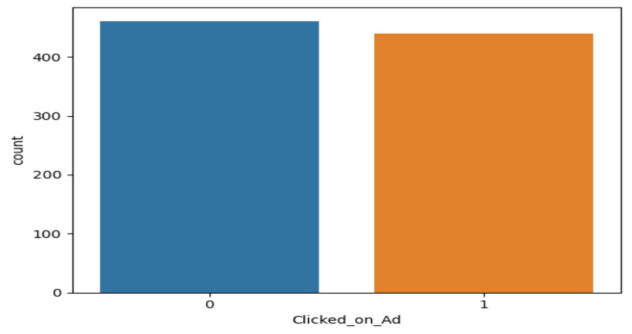
Target Variable Distribution of Customer clicked on Ad and not clicked
0 = Clicked; 1= Not clicked

Slide 8
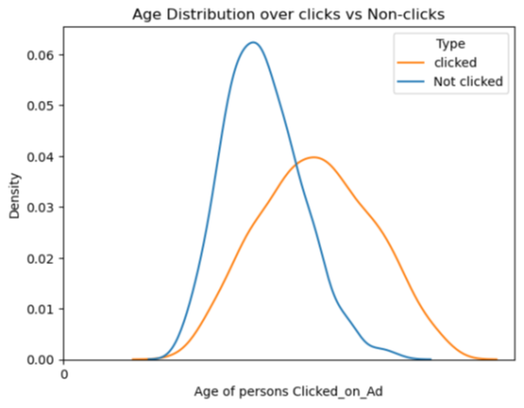
Age Distribution over clicks and non-clicks
The majority of individuals who clicked on ads are approximately 40 years old, indicating a significant preference within that age group for engaging with advertisements.

Slide 9
Proportion of transaction by Gender
Clicked on Ad Gender Wise
In the dataset, there's a slightly higher proportion of females 51.7% has seen the ads compared to males 48.3%, indicating a relatively balanced engagement across genders.

Slide 10
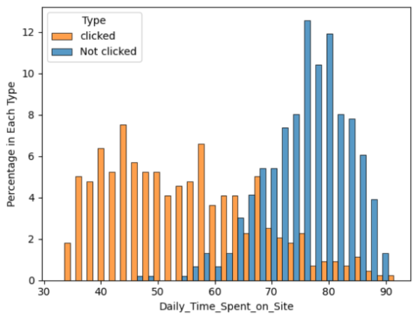
Daily time spent on Site vs Clicked on Ad
People who clicks on ads are more who spends time on site around 42 hours to 60 hrs

Slide 11
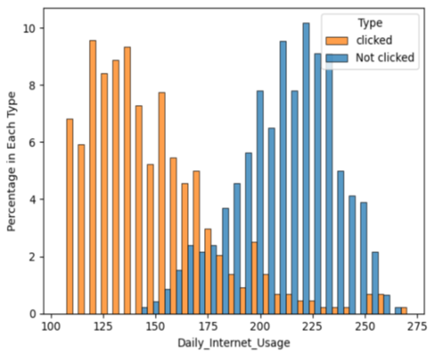
Daily Internet Usage vs Clicked on Ad
People who clicks on add are more who spends time on internet around 120 to 130 MB.​

Slide 12
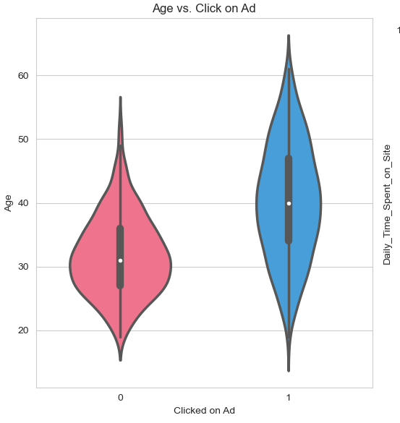
Bivariate Analysis
1. AGE:
The density of no is highest around age of 30, indicating that users in their 30s are less likely to click on ads.
The density of yes is highest around age of 40, indicating that users in their 40s are morel ikely to click on ads.
No distribution appears wider and shorter, indicating that it has a higher density and lower variablity.
Yes distribution appears slimer and longer, indicating that it has a lower density and higher variability.
No distribution has a longer tail towards higher ages, indicating that it has a positive skew and has outlier.

Slide 13
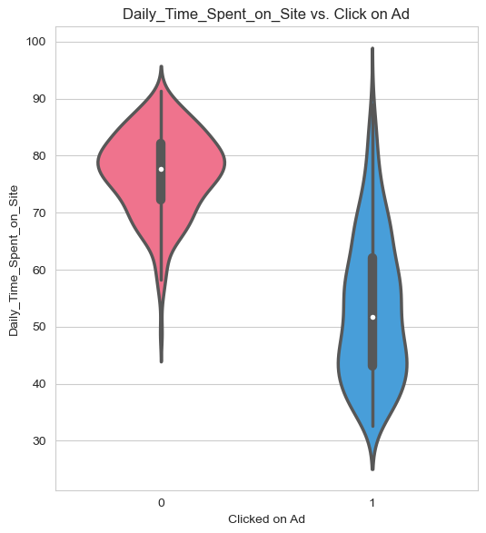
2. Daily Time Spent on Site
The density of no is highest around minutes of 75, indicating that users who has daily spentaround 75 minutes
On internet are less likely to click on ads.
The density of yes is highest around minutes of 50, indicating that users who has dailyspent around 50 minutes on internet are more likely to click on ads.
No distribution appears shorter, indicating that it has a lower variablity.
Yes distribution appears longer, indicating that it has a higher variability.
No distribution has a longer tail towards lower minutes, indicating that it has a negativeskew and has outlier.

Slide 14
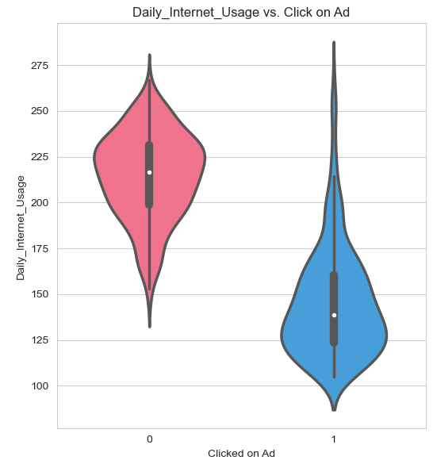
3. Daily Internet Usage
The density of no is highest around minutes of 210, indicating that users who has dailyspent around 210 minutes on internet are less likely to click on ads.
The density of yes is highest around minutes of 130, indicating that users who has dailyspent around 130 minutes on internet are more likely to click on ads.
No distribution appears wider and shorter, indicating that it has a higher density and lowervariablity.
Yes distribution appears slimer and longer, indicating that it has a lower density and highervariability.
No distribution has a longer tail towards lower minutes, indicating that it has a negativeskew and has outlier.
Yes distribution has a longer tail towards higher minutes, indicating that it has a positiveskew and has outlier.

Slide 15
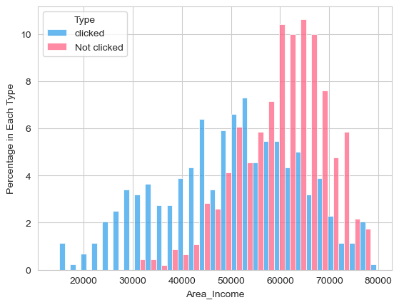
Area Income vs Clicked on Ad
People who clicks on ads are more who spends time on site around 42 hours to 60 hrs​

Slide 16
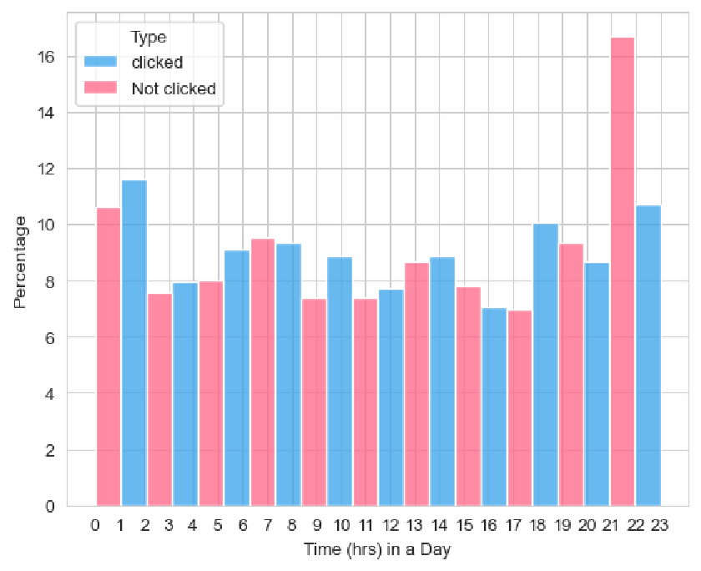
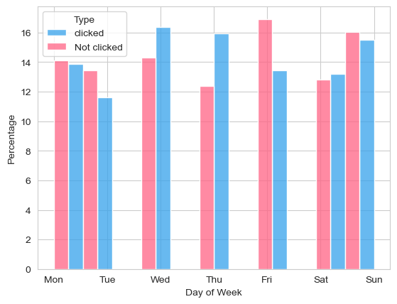
Cyclicality of Clicked on Ads
Trend in a day
Weekly Trend
Monthly Trend

Slide 17
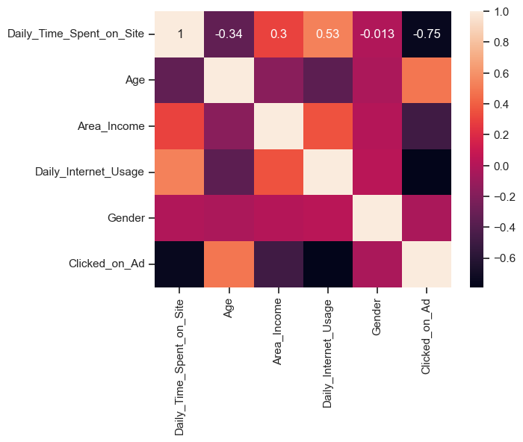
Heat Map of Variables
Explains the correlation of all numerical features.
Also we can identify if any two independent features are corelated to each other.ie., Multicollinearity.

Slide 18
Model Building
Encoding:
Converting categorical variables into numerical representations for machine learning algorithms.
Splitting the Data Frame:
Dividing the dataset into 2 data frames independent features and dependent feature i.e., target variable to evaluate
Train test split:
Dividing the dataset into training and testing sets to evaluate model performance.
Scaling:
Standardizing numerical features to ensure uniformity and improve model convergence during training.

Slide 19

Models
Logistic Regression:
Decision Tree
Random Forest
Evaluation matrix:
Accuracy
Precision
ROC - FPR, TPR, Threshold
AUC
Confusion Matrix
Classification report

Slide 20
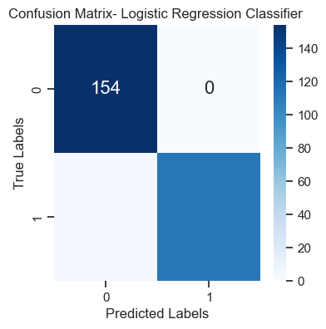
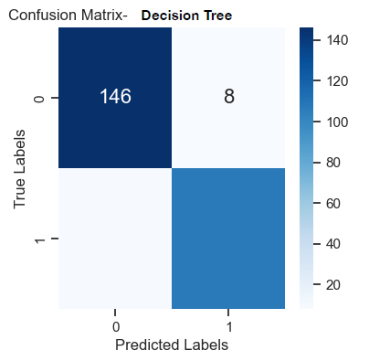
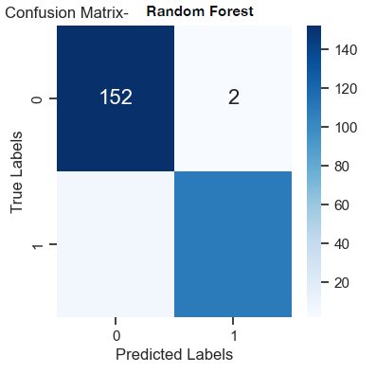
Logistic Regression
Decision Tree
Random Forest
Accuracy: 0.9851851
Accuracy: 0.937037037
Accuracy: 0.96666666

Slide 21
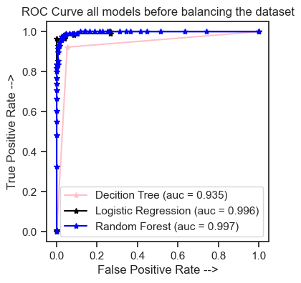
ROC Curve
A Receiver Operating Characteristic (ROC) curve is a graphical representation used to evaluate the performance of a classification model, typically binary classification models like those used in click ad prediction
In this case, ROC curve is used to assess how well the model is able to distinguish between positive (clicked) and negative (not clicked) instances

Slide 22
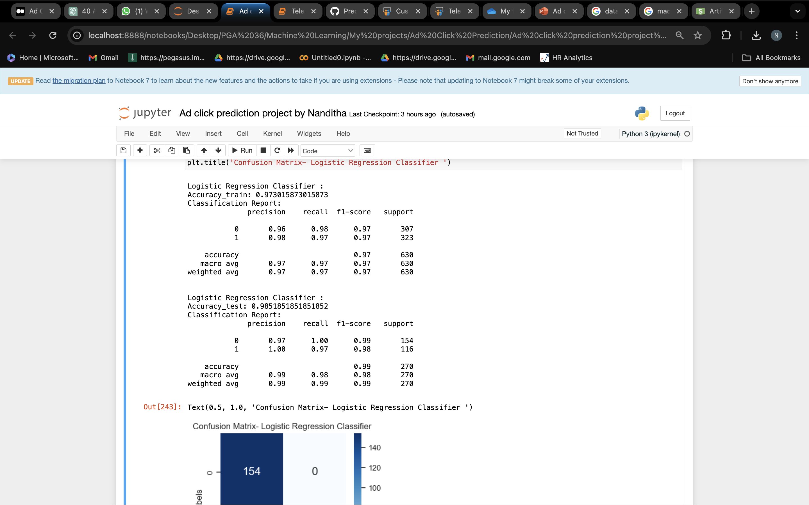
Summary
Logistic Regression model performs well compare to decision tree and random forest with accuracy 98.515 and classification report is below:
For given ad clicked dataset
with 900 ads of certain features Logistic
regression model performs well.

Slide 23

Thank you
By Nanditha J K

